Slide 1
PUBLIC SAFETY INFORMATION FORUM
14 September 2024

Slide 2
AGENDA
 | ITEM | LEAD | TIME
1. | Welcome and attendance | Mareme Mathosa, Chairperson | 10:00 – 10:05
2. | Safety Minute | Mologadi Kekana, General Manager: Compliance Services | 10:05 – 10:10
3. | Minutes of the previous meeting | Mareme Mathosa, Chairperson | 10:10 – 10:20
4. | Matters arising from previous minutes | Mareme Mathosa, Chairperson | 10:20 – 10:25
5. | Necsa Group Update | Loyiso Tyabashe, GCEO | 10:25 – 11:00
 | Comments and Discussion | Mareme Mathosa, Chairperson | 11:00 – 11:10
6. | NNR Update | Wesley Damon, Acting Programme Manager: Nuclear Technology and Waste Projects | 11:10 – 11:20
 | Comments and Discussion | Mareme Mathosa, Chairperson | 11:20 – 11:30
7. | General | Mareme Mathosa, Chairperson | 11:30 – 11:40
8. | Closure | Mareme Mathosa, Chairperson | 11:45

Slide 3
Mr Loyiso Tyabashe
Group Chief Executive Officer

Slide 4
COMPLIANCE WITH PUBLIC SAFETY REQUIREMENTS
Necsa is honoured to get opportunities like this one where we engage with members of the public and other key stakeholders who have an interest in safe operations at Necsa
Public Safety Information Forums (PSIF) are legislated meetings that Necsa conducts quarterly to ensure that our community members are continuously informed on key matters related to safety and we also get to address other issues of interest / questions for clarity
As a growing organisation, it is incumbent upon Necsa to share its future development plans in order to give members of surrounding communities an opportunity to give input into those developments and get information on how Necsa will ensure safety during and after project development
It is important for members who attend the meetings to make other relevant communities aware about these meetings but also to share information further because safety is our collective responsibility

Slide 5
INDUSTRY UPDATE
Following changes at Cabinet level, Necsa now reports to the Ministry of Electricity and Energy under the stewardship of the Honourable Dr Kgosientso Ramokgopa.
The Gazetting of the 2.5GW new nuclear power programme has been withdrawn to afford Nersa an opportunity to engage all stakeholders on the process.
On Thursday, 12 September, the Minister led a Nuclear Energy Summit where stakeholders engaged on the current status of nuclear as a technology in South Africa and opportunities that can be leveraged for economic growth, social justice and sustainability.
The nuclear industry will be converging for the annual General Conference of the International Atomic Energy Agency (IAEA) in Vienna next week – an international body of the United Nations that regulates nuclear technology globally. South Africa and Necsa will be represented.

Slide 6
BUSINESS UPDATE
The Necsa Group financial year 2023/24 ended positively.
  Audited performance against annual targets at 93% and profitability achieved.
  Audit outcomes at unqualified and clean for Necsa Group of companies.
Necsa employees have played an important role in shaping a sustainable organisation where our mantra of Performance, Profitability and a positive Audit Outcome (PPA) could be achieved.
The target for the year ahead is maintaining improvements across the Group and entrenching a culture of High Performance rooted in our values.
The Necsa Group emphasizes wellness for the employees to ensure they deliver on the mandate. A successful Wellness Day yesterday attended by Board members and employees – recommitment to Necsa values.

Slide 7
Nuclear Operations Update

Slide 8
SAFARI-1 OPERATIONAL PERFORMANCE
SAFARI-1 continues to operate safely with high availability
  Annual Target : 287 days
  Quarter 1 (01 April – 30 June 2024) :
    Target 73,89 (74) days
    Actual Performance 72,89 (73) days
Ageing Management Programme is being implemented and yielding positive results
Other Nuclear Installations within the Necsa site are operational and compliant to safety requirements.

Slide 9
MULTI-PURPOSE REACTOR (MPR)
The MPR project scope remains unchanged at the end of the feasibility study report:
  The reactor facility
  Fuel elements, control rods and target plate fabrication plant
  Neutron beam line centre
  Fuel and material testing
  On-site accommodation
  Design and manufacturing capability for nuclear components
  Site Infrastructure upgrade
MULTI-PURPOSE REACTOR (MPR) CURRENT KEY MILESTONES
01
01
The Feasibility Study submitted to the Minister of Mineral Energy and Electricity for noting and legislative support
The Intermediate Business Case (IBC) has been submitted to Infrastructure South Africa for approval so the project can be listed as a National Strategic Integrated Project (SIP)
02
03
Preparation and completion of the Request For Proposal (RFP)
Estimated Completion date: Dec 2033

Slide 10
THABANA PIPESTORE
  The proposed extension will create additional storage capacity for the spent fuel from SAFARI and for U-Residue from NTP.
  NR has decided that further public debate related to the proposed extension of the Thabana Pipestore is not warranted.
  Necsa is addressing all outstanding issues with the NNR before construction can be initiated.
THABANA PIPESTORE CURRENT KEY MILESTONES
01
01
Manufacturing of the Pipes
02
Appoint construction supplier
03
Construct and install Pipes
Estimated Completion date: Mid 2025

Slide 11
NTP Update

Slide 12
PERFORMANCE TO DISPLAY SAFETY INTEGRATION INTO OPERATIONS
Strategic Focus Areas
  Safety performance within targets and 100% compliance with licenses to operate
  Composite SHEQ Index target achieved
  Full compliance to all regulatory approvals and authorisations
    Radiological
    Pharmaceutical
    Nuclear

Slide 13
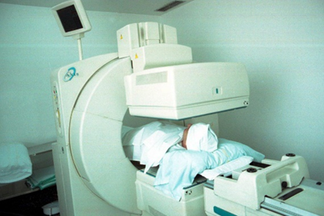
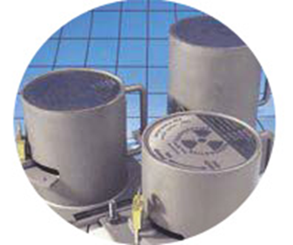
PERFORMANCE TO DISPLAY SAFETY INTEGRATION INTO OPERATIONS
  Medical Products
  Mo-99, I-131, Lu-177, FDG, Mo-99/Tc-99 generators, etc.
  Diagnosis and Treatment of various types of cancer
  NTP products have a significant impact on the fight against cancer and other diseases in SA and globally
  Industrial Isotopes
  Ir-192, Cs-137, Kr-85
  Industrial radiography, process control, smoke detectors

Slide 14
Pelchem Update

Slide 15
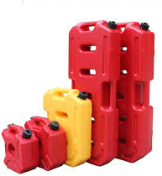

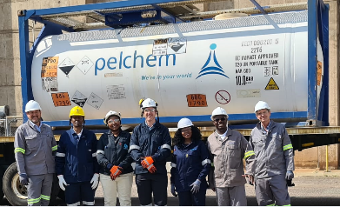
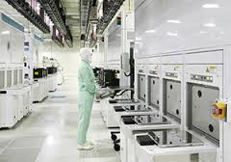
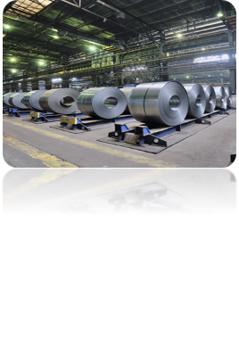


NATURE OF BUSINESS AND KEY FOCUS AREAS
Pelchem consists of 4 facilities
  Anhydrous Hydrogen Fluoride and Hydrofluoric acid (AHF)
  Various Fluorine gas mixtures
  Xenon Difluoride
  Surface Fluorination services
Key Markets Serviced include
  Petrochemical (AHF)
  Stainless Steel manufacturing (70% HF)
  Plastics industry (SFL)
  Semiconductor industry – electronics (XeF2)
  Both domestic and international
Key Business Update
  Continued focus on improving financial performance year on year whilst managing operation of ageing plant
  Increased maintenance to improve plant reliability and customer service
  HF plant currently under care and maintenance and following an importing model for related activities
  Safety performance to remain within target and full compliance with all operating licenses
  Continuous monitoring of environmental impacts assists in spotting areas of concern in time and addressing issues (e.g. stack emission and fluorides on effluent)

Slide 16
Safety & Security

Slide 17
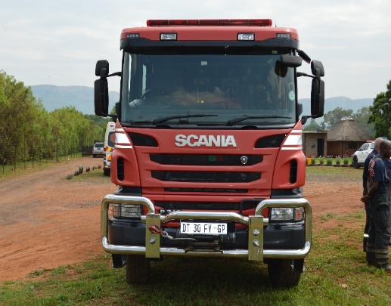
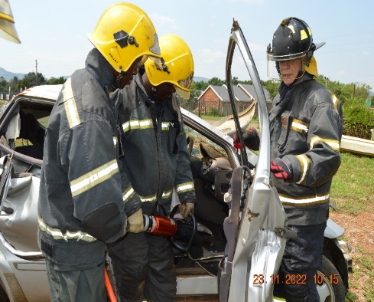
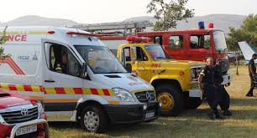
COMMUNITY SERVICES (1 OF 2)
Necsa Emergency provides a 24 hour service to respond to on-site emergency related situations for our facilities. The Services provided include:
Fire Fighting
Vehicle accidents
Ambulance services
Emergency Number
NECSA EMERGENCY SERVICES
012 305 3333/4/5
Fire services (veld and structural fires) are provided to Madibeng upon their request.
  Necsa Emergency Services respond to emergencies in the Necsa vicinity as well as the community of Hartbeespoort area e.g. trauma, medical emergencies, and extrication of patients entrapped due to vehicle accidents, including vehicle fires.
Emergency communications to relevant contracted hospitals/health facilities in case of serious emergencies

Slide 18
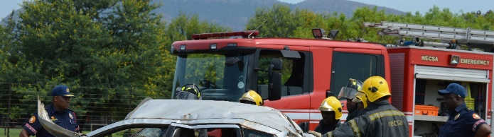
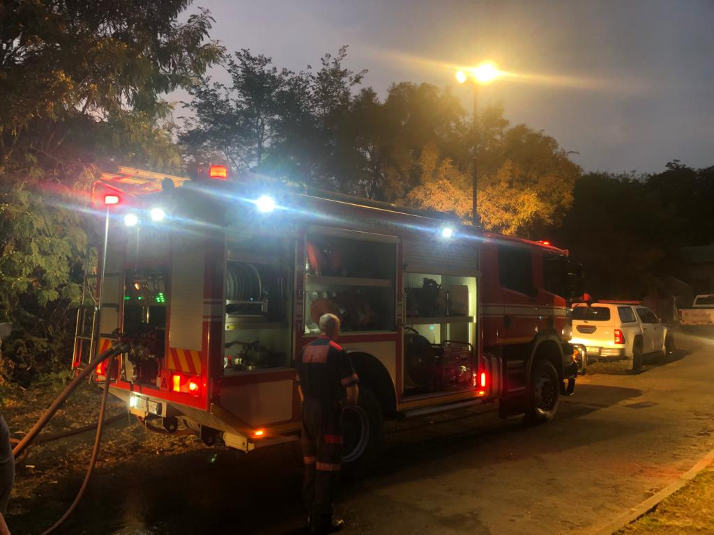
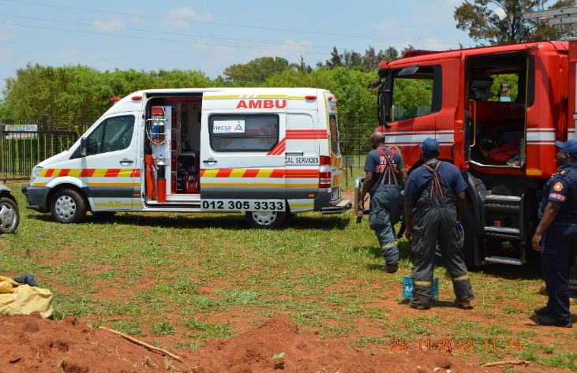
COMMUNITY SERVICES (2 OF 2)
June 2024 – August 2024
Vehicle Accidents
Number of vehicles accidents | 7
Number of patients Transported | 0
Animal related vehicle accidents | 0
Fire Calls
Number of fire of calls | 8
Number of patients transported | 0
Ambulance Calls
Number of fire of calls | 14
Number of patients transported | 10

Slide 19
2024 SCHEDULED EMERGENCY EXERCISES
07 May
Chemical Exercise
04 September
Security Exercise
15 November
Radiological Exercise
Jan ‘24
Feb ‘24
Mar ‘24
Apr ‘24
May ‘24
Jun ‘24
Jul ‘24
Aug ‘24
Sep ‘24
Oct ‘24
Nov ‘24
Dec ‘24
28 March
Radiological Exercise
11 July
Radiological Exercise
25 October
Chemical Exercise
Exercises are conducted to test readiness for radiological, chemical and security events. During exercises, depending on the objectives of the exercise, the site alarm might be activated, where SMS notices are sent to the members of the public.
On 11 July 2024, Necsa successfully conducted a Radiological Emergency Exercise.
On 04 September 2024, Necsa successfully conducted a Security Emergency Exercise with involvement of SAPS.
Necsa will conduct the fifth Emergency Exercise on the 25th of October 2024, which will be a Chemical Emergency Exercise. The Exercise will be conducted with the City of Tshwane with the exercise scene being at R104.
Necsa continues with controlled veld burning for fire breaks.
19

Slide 20

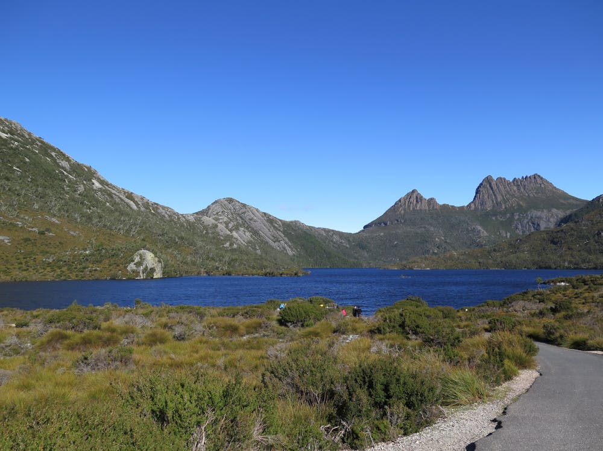

RADIOLOGICAL PATHWAYS THAT ARE MONITORED
This monitoring is conducted to assess the possible impact on the public or environment due to radiation resulting from operations and discharges from Necsa site.
Air monitoring
Terrestrial environment
Surface and Groundwater
Stacks
Fallouts
Atmospheric particulates & iodine
Tacky sacks
Thermo Luminescent Dosimeter (TLD)
Soil (Annual & Thabana)
Sediment
Sewage sludge (Pel East & Pel West sewage Plants)
Vegetation on site (Thabana)
Vegetables
Fish (Dam & Crocodile River)
Meat
Milk
Community Drinking water – Kosmos and Hartbeespoort
Crocodile River
Boundary streams
Boreholes (Annual drinking water & Thabana)
NNR further conducts independent sampling and analysis

Slide 21
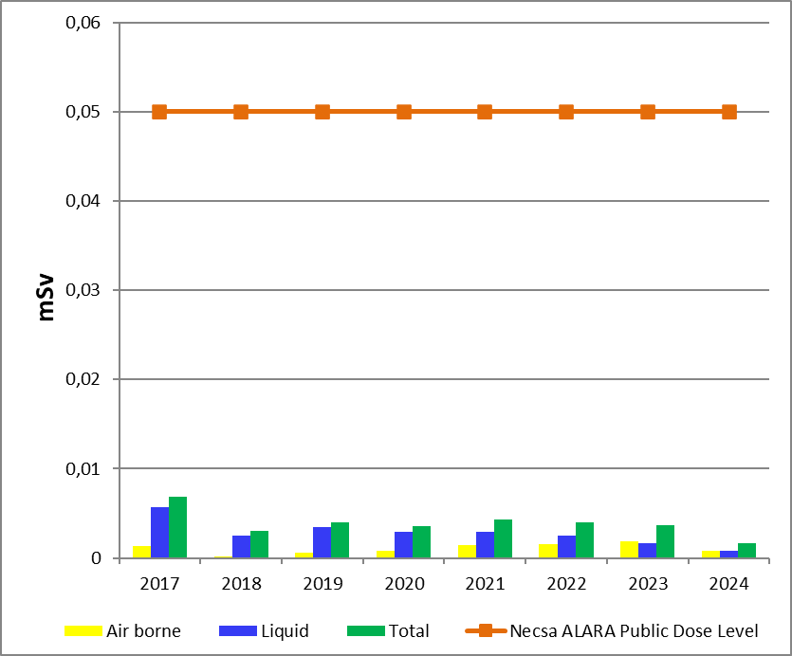
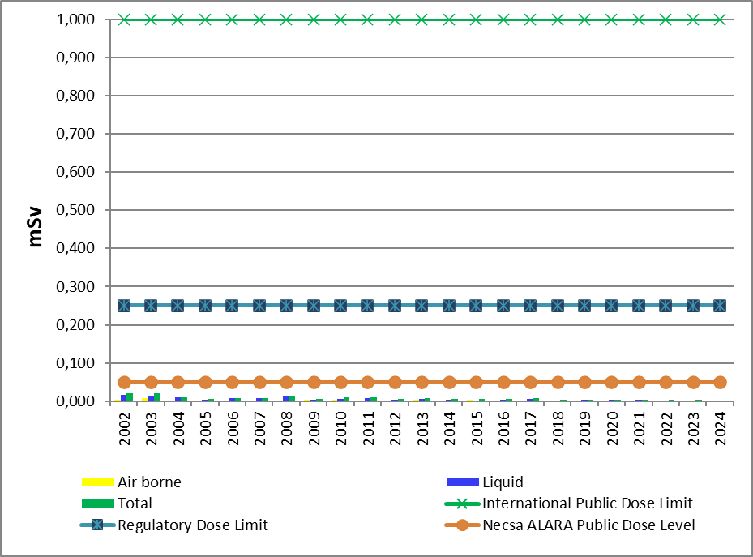

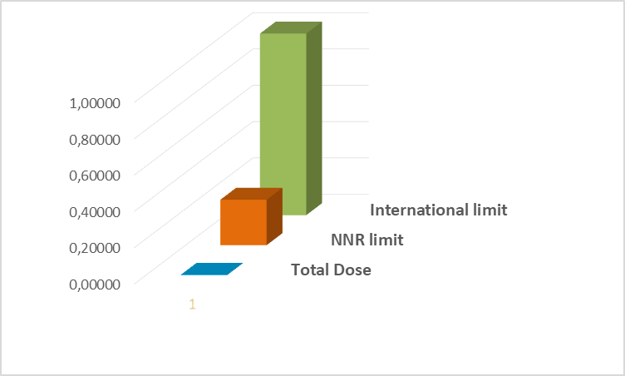
PUBLIC DOSE
 |  | Total Dose Jan-June 24 | Necsa ALARA Level | Regulatory dose limit | International limit
Public dose | (Jan - June) 2024 | 0,00171 mSv | 0,05 | 0,250 mSv | 1mSv
The public dose for the 2nd quarter 2024 (April to June) due to radioactive discharges to the atmosphere was 0,000332 mSv and the public dose due to radioactive effluent released to the Crocodile River was 0,000597 mSv.
The cumulative public dose (January to June) 2024 was 0,00171 mSv that is 0.682 % of the regulatory dose limit of 0,250 mSv.
These results show that the dose impact to the public is low relative to the regulatory dose limit.
21

Slide 22
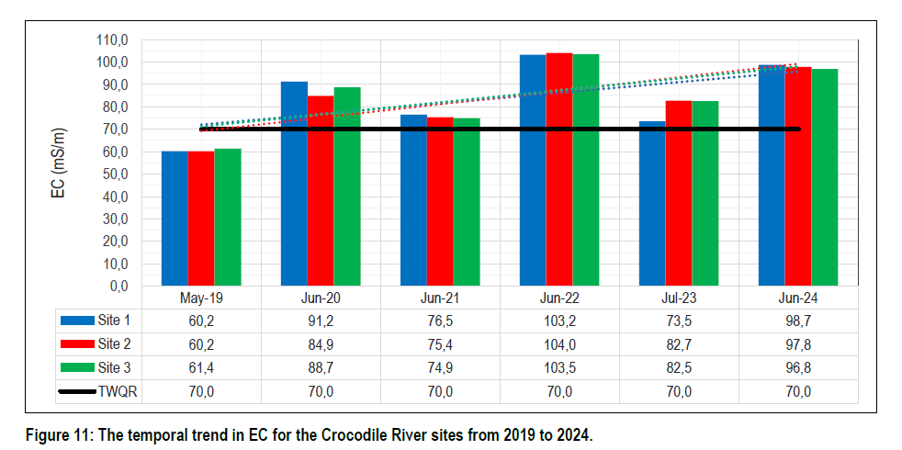
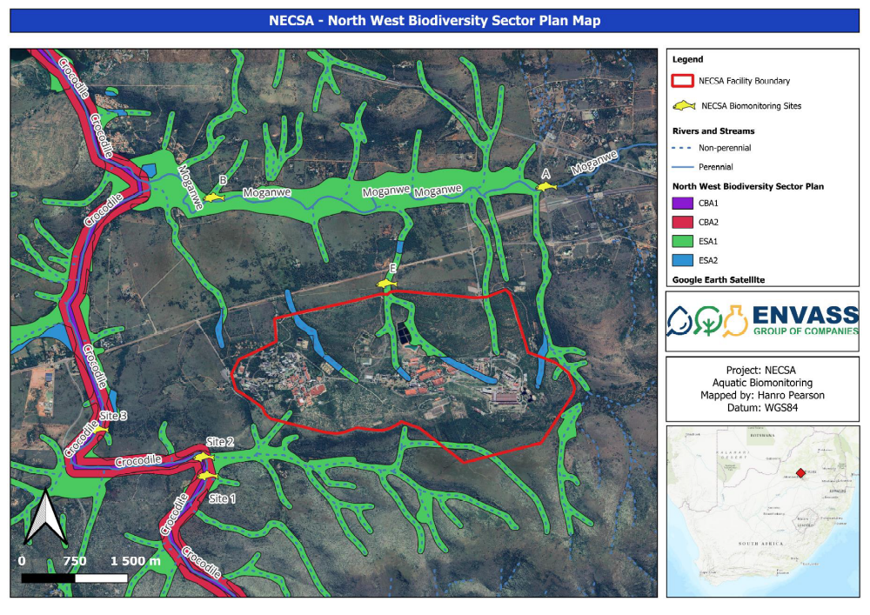
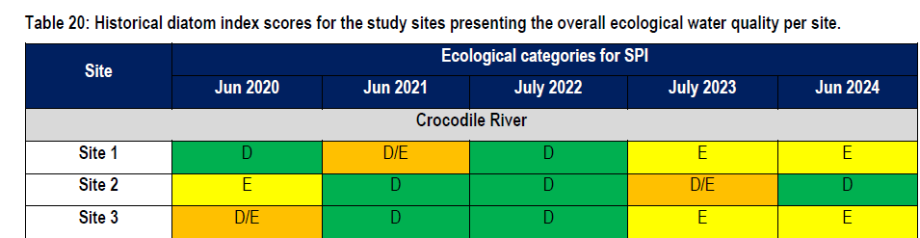
WATER QUALITY CROCODILE RIVER – BIOMONITORING ENVASS
Moderate water quality modifications were evident in the Crocodile River, as indicated by elevated Electrical Conductivity (EC) and decreased Dissolved Oxygen (DO) levels. The study found that EC levels exceeded the recommended Target Water Quality Ranges (TWQR) and RQO limits. EC levels decreased slightly in a downstream direction from Site 1 to Site 3, indicating no discernible effect from the Necsa discharge point between Site 1 and Site 2. The study indicates that the accumulation of runoff and effluent discharge from upstream land use practices in the catchment area, especially from urban areas and commercial agriculture, is contributing to the modified water quality.
According to biotic responses (macroinvertebrate and diatom communities), the 2024 dry season assessment revealed an improvement in macroinvertebrate conditions from the 2023 survey, marked by higher total sensitivity scores and a shift to a higher ecological category (from Class E/F to Class D) in a downstream direction. Therefore, no evident impact from the Necsa discharge point between Site 1 and Site 2 was observed.

Slide 23
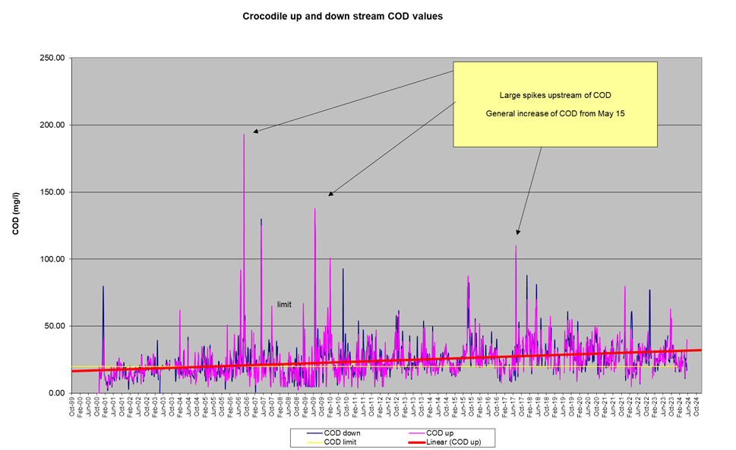
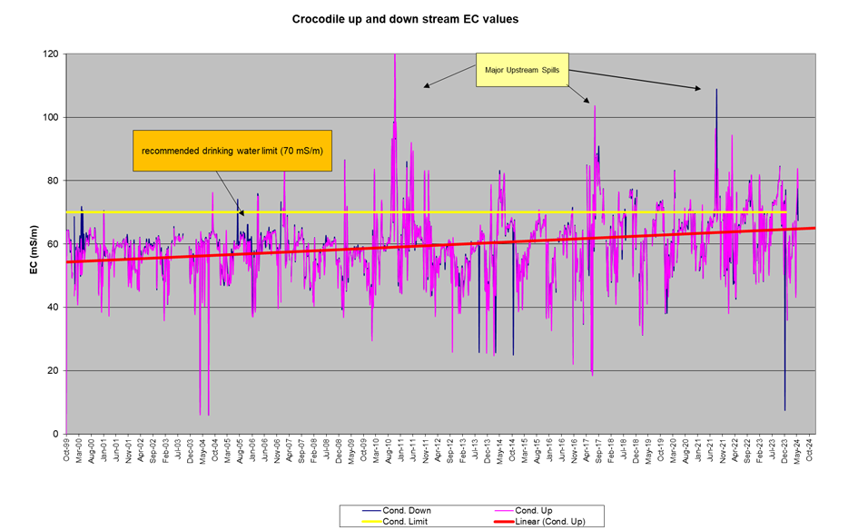
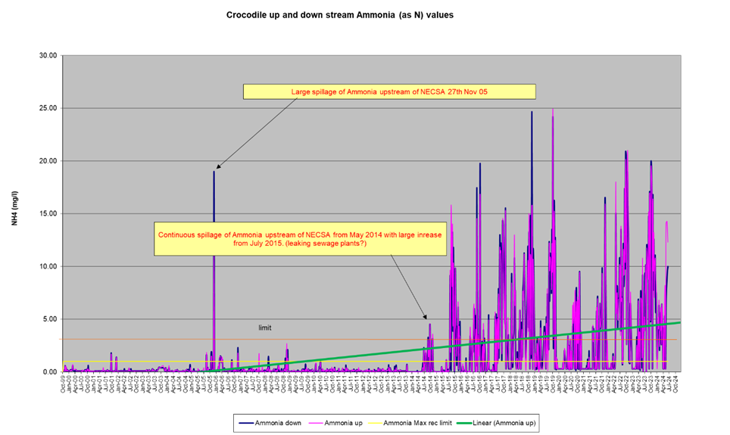
WATER QUALITY CROCODILE RIVER – NECSA ANALYSIS
Electrical Conductivity (EC)
Chemical Oxygen Demand (COD)
EMG member of NW-Integrated Provincial Water Monitoring Committee
Necsa (EMG) submit an Annual Water Report to DWS annually
Ammonia (as N)

Slide 24
LANDUSE CENSUS
This is a routine survey, not linked to any problem. Section 38 of the National Nuclear Regulator (Act 47 of 1999) requires that the licensee (Necsa) must conduct a landuse census every 30 months.
Section A of the questionnaire:
1. Disaster Management Group:
Land use census survey is conducted to provide information and contact information for Necsa Emergency plans to identify possible critical groups surrounding the Necsa property for the protection of public Health and the Environment. These plans are coordinated through the Disaster Management Act 57 of 2002.
2. PSIF:
The contact information is also shared with the Corporate Communication, Branding and Stakeholder Relations Group to enable distribution of information to the public (PSIF meetings, public communication, EIA / NNR public participation, etc.).
Any information supplied, will be handled in compliance with the current POPI Act 2013 (Act No. 04 of 2013): Protection of Personal Information Act.
Section B of the questionnaire:
The SHEQ-INS-8340 document specifies the radiological environmental surveillance requirements for the Pelindaba site and vicinity to identify, in each of the eight compass sectors:
the nearest residence
nearest garden routinely producing fresh vegetables or fruit
the nearest milk producing animal within five kilometers of the nuclear facilities at Pelindaba
the nearest garden that is irrigated with Crocodile River water downstream of the Pelindaba effluent release point, up to the inlet into the Hartbeespoort dam
the nearest drinking water borehole and the nearest processed community water supply

Slide 25
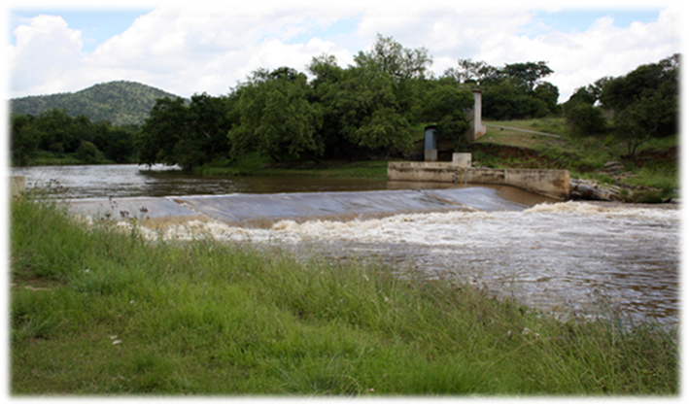
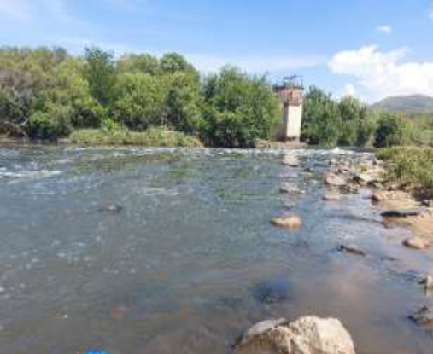
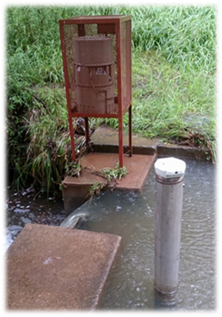
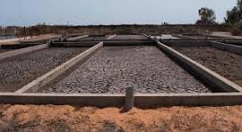
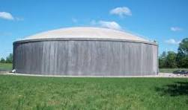
WATER USE LICENCE APPLICATION (WULA) TO DWS IN TERMS OF SECTION 21 OF THE NATIONAL WATER ACT (ACT 36 OF 1998) – ON-GOING
Necsa is operating under Water Permit 16/2/7 A210/B9. A directive was issued to Necsa in 2005 by Region Director: NW Province to Necsa in this regard.
Necsa is applying for the following Section 21 water uses:
21(a) Abstraction of water from a water resource (Crocodile River)
21(b) Storage of water (Reservoirs, Crocodile River in stream dam & dam South of Pelindaba West)
21(c) Impeding the flow of water in a watercourse (Monitoring weirs, Crocodile River Inlet- Outlet)
21(f) Discharging of waste or water containing waste partially through a conduit (Discharge of effluent to the Crocodile River)
21(g) Disposing of waste in a manner which may detrimentally impact on a water resource (All Evaporation pans, Sewage Sludge beds & wastewater from P2200 & P2400– sludge beds)
21(j) Removing water found underground if it is necessary for the efficient continuation of an activity or for the safety of people (Possibly: YM Trench – remediation measure)

Slide 26

CONCLUSION
Compliance to regulations and licensing conditions is key to our business at Necsa for continued sustainability
Communities around our facility are important stakeholders and warrant to have Necsa accounting to them on safety matters
Leadership accountability and a stable working environment has led to improved safety and operational performance
Necsa is grateful for the members of the public and other stakeholders who participate in Public Safety Information Forums and for taking an interest to engage with Necsa effectively
Projects for growth will follow on the current safety base and regulatory processes

Slide 27
BACK-UP SLIDES

Slide 28
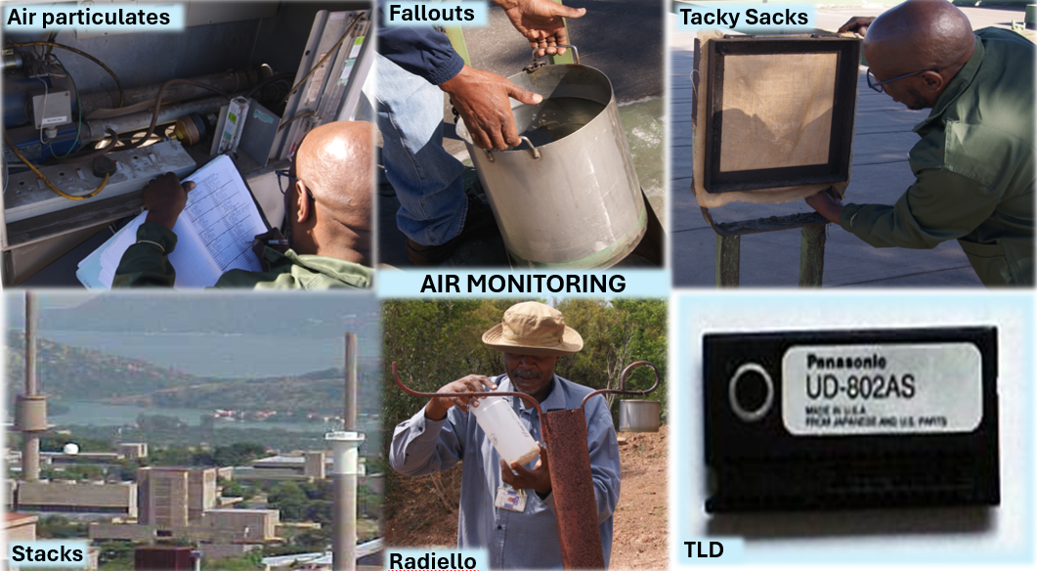
OVERVIEW ENVIRONMENTAL MONITORING

