Slide 1
Pelindaba Public Safety Information Forum (PSIF)
4th Meeting of 2024/25 FY
29 March 2025

Slide 2
PSIF AGENDA – 29 MARCH 2025
 | ITEM | LEAD | TIME
1. | Welcome and Announcement of new Chairperson | Gino Moonsamy | 10:00 – 10:05
2. | Safety Minute | Noxolo Kunene, Head: Licensing and Regulatory Management | 10:05 – 10:10
3. | Minutes of the previous meeting | Chairperson | 10:10 – 10:20
4. | Matters arising from previous minutes | Chairperson | 10:20 – 10:35
5. | Necsa Group Update | Loyiso Tyabashe, Group Chief Executive Officer | 10:35 – 11:00
 | Comments and Discussion | Chairperson | 11:00 – 11:10
6. | NNR Update | Wesley Damon, Acting Programme Manager: Nuclear Technology and Waste Projects | 11:10 – 11:20
 | Comments and Discussion | Chairperson | 11:20 – 11:30
7. | General | Chairperson | 11:30 – 11:40
8. | Closure | Chairperson | 11:45

Slide 3
Public Safety Information Forum
(PSIF) Presentation
4th Meeting of 2024/25 FY
Mr Loyiso Tyabashe
Group CEO
29 March 2025

Slide 4
LEGISLATIVE REQUIREMENTS FOR PUBLIC SAFETY INFORMATION FORUM MEETINGS
  Necsa, as a the holder of a nuclear installation license, holds Public Safety Information Forum to inform people living in the area that falls under the scope of the emergency plan on nuclear safety and radiation safety matters related to its activities.
  Necsa’s licensing requirements guide us in terms of key areas where we need to account to communities about the impacts of our business.
  Relevant stakeholders invited to an open meeting
  Nuclear Energy Act
  Environmental compliance Acts
  Occupational Health and Safety Act
  National Nuclear Regulator (NNR) Act
  Disaster Management Act
  Mission: To develop and safely utilise nuclear, radiation, and related technologies to make a socioeconomic impact in diverse global markets through commercial and non-commercial technologies, in an environmentally responsible manner.
  Necsa values include “Safety First”

Slide 5
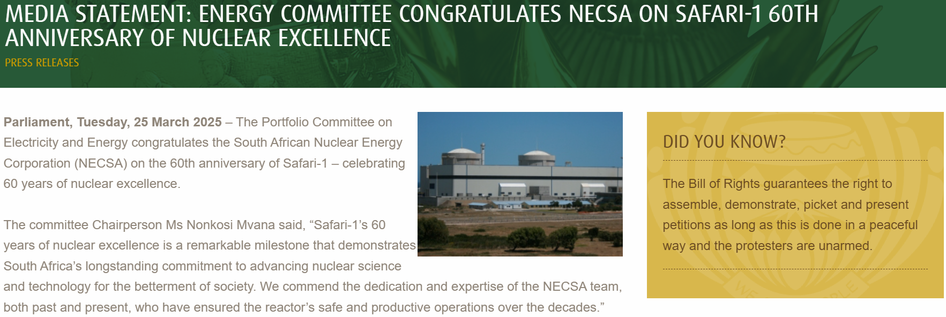
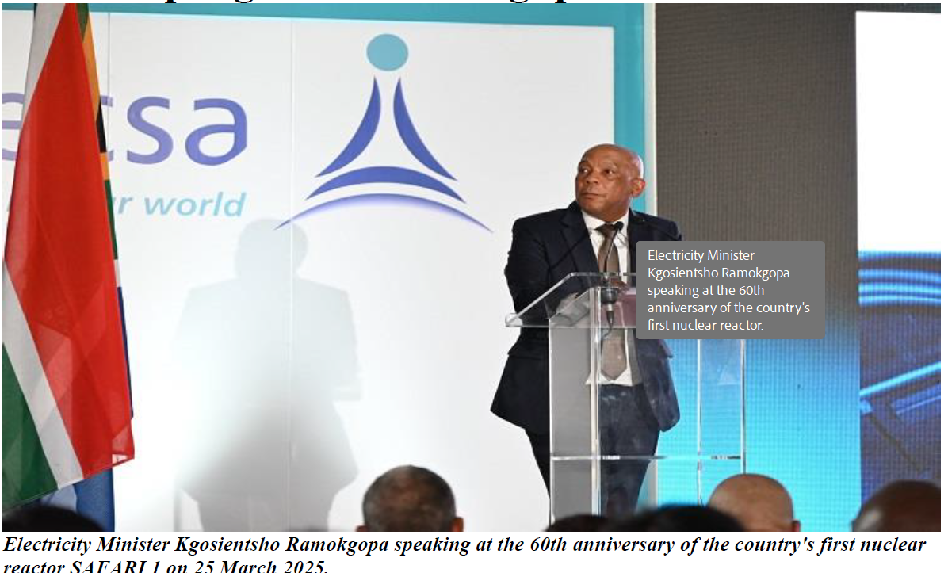
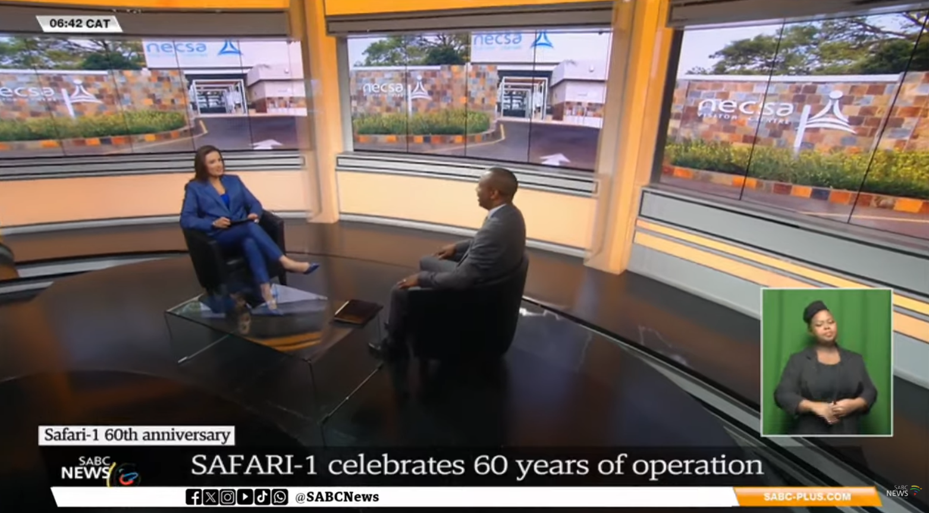
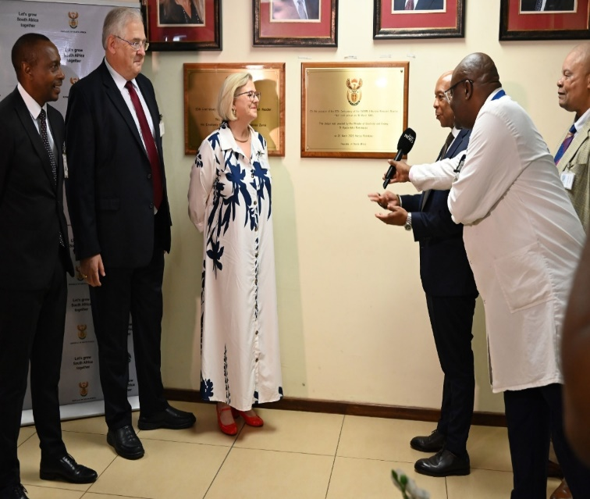
BUSINESS UPDATE
The SAFARI-1 Rector (South African Fundamental Atomic Research Installation) reached 60 years on 18 March 2025.
Necsa Group employees celebrated this remarkable milestone on 18 March 2025.
A bigger event for employees and external stakeholders was held on 25 March 2025 led by the Minister of Electricity and Energy Dr Kgosientsho Ramokgopa. He was supported by his Deputy Minister, Ms Samantha Graham-Mare.

Slide 6

NEW APPOINTMENT IN HUMAN CAPITAL
Ms Sithembile Mbuyisa appointed Group Executive: Human Capital with effect from 1 March 2025
A well-experienced business leader with extensive Human Resources management experience at master practitioner level obtained from both the corporate and public sectors in local and global organisations
She brings to Necsa a wealth of experience in Strategic Human Capital Leadership, Corporate Governance, Ethics and Social Compliance, Strategic Communication, Corporate Social Responsibility and broader Business Operations Management
Ms Mbuyisa holds a Master of Business Leadership (MBL), Honours Degree in Social Sciences, Postgraduate Diploma in Human Resources Management from UNISA, People Leadership Development qualification through Development Dimensions International (DDI)

Slide 7
NECSA COMPLIANCE
Necsa has a mature SHEQ system as a process base license, justifying adequate systems to ensure safe operations in compliance to NNR and other applicable legislative requirements, as well as international best practice.
The system allows for reporting of events, self evaluation to identify areas of improvement.
A comprehensive environmental management plan with technically justifiable monitoring programme is implemented and trends monitored and mitigations activated as appropriate.
An emergency plan is implemented at different levels of operations starting at building level, emergencies that could impact the site and beyond the Necsa parameter.
Necsa regularly reports to the NNR on compliance related matters, as well as reporting to other regulators as applicable.
Necsa facilities are still in compliance to Nuclear Installation License requirements with findings from internal and external audit/inspection findings being continuously addressed.
A robust event management process is implemented, which is also applied to address inspection findings and any non-conformances. Events are reported, investigated and corrective and preventive actions are implemented accordingly.
Oversight is regularly reviewed and strengthened to ensure effectiveness of processes for continuous improvements.
All safety targets have been met and authorisations valid.

Slide 8
NNR AUTHORISATIONS
NNR (40 NILs)
02
03
04
05
06
07
08
09
10
11
12
13
14
15
16
17
18
19
20
21
22
23
24
25
26
27
28
29
30
31
32
33
34
35
36
37
38
39
40
41
NIL02 – Safari Operations
  New revised license limited to December 2030
  Project initiated for long term operation
NIL11- Thabana Pipe Store
  NNR approval to extend Thabana requested to enable capacity for spent fuel
Waste Projects
  Cold commissioning for Test Smelter in progress
  Hot commissioning of Volume Reduction Facility completed with report in progress addressing areas of improvement.
Significant progress on ensuring compliance to new NIL conditions.
Section 38 of the National Nuclear Regulator Act (Act 47 of 1999) requires that the licensee (Necsa) must conduct a land use census every 30 months. The land use census will be closed end March. Thank you to all who responded

Slide 9
OTHER AUTHORISATIONS
SAHPRA*
DFFE (7)
DWS (1)
HAZARDOUS SUBSTANCE ACT - (ACT 15 OF 1973)
NATIONAL ENVIRONMENTAL MANAGEMENT: BIODIVERSITY ACT (10/2004)
NATIONAL ENVIRONMENTAL MANAGEMENT: WASTE ACT (59/2008)
NATIONAL ENVIRONMENTAL MANGEMENT: AIR QUALITY ACT (39/2004)
NATIONAL WATER ACT (36/1998) (Directive)
All SAHPRA Authorisation in good standing.
DFFE requirements are met with the Air Emission License issued by Bojanala in good standing.
Necsa is operating under Water Permit 16/2/7 A210/B9. A directive issued in 2005 by Region Director: NW Province to Necsa in this regard.
Water Use License Application (WULA) to DWS in terms of Section 21 of the National Water Act (ACT 36 OF 1998) in progress.
Compliance inspection was conducted by DWS in November 2024 while the technical engagement were held in December 2024.

Slide 10
ENVIRONMENTAL MONITORING
RADIOLOGICAL RELEASES | Gaseous releases | NTP stacks (4) SAFARI -1 stack (1) Inconsequential stacks (29) | NNR compliance (0.05 mSv)
 | Effluent Release | Effluent release to the Crocodile River | NNR compliance (0.15 mSv)
WATER PERMIT | Effluent Release | Effluent release to the Crocodile River | DWS compliance (250 000 m³) per water year
AIR EMMISION LICENCE | Gaseous releases | Acids Production - Hydrogen Fluoride [HF] - Area V-60 Salts Production – Sodium Silica Fluoride [Na₂SiF₆] - Area V-69 Fluorine Generation – [F2] - B-H1 Surface Fluorination Production Plant - B-E3/4 Fluor Organics Production - Potassium Propanoate. [perfluoro 23- methoxypropyl] - B-C2 | Pelchem AEL licence BPDM/AEL/OCTOBER2020 Annual Air Allowable Emissions (Kg/a) @ 5mg/m³ = 17 695 kg
All environmental monitoring results are significantly below regulatory limits - green

Slide 11
EMERGENCY PLAN
Alert
A situation that could develop into a Site or General Emergency and therefore requires notification of all emergency functionaries (internal and external) in order to obtain a state of readiness to respond.
Site Emergency
An emergency condition that poses a serious hazard on-site, but poses no serious hazard to the public off-site.
General Emergency
An emergency condition that poses or potentially poses a serious hazard off-site requiring full implementation of the EP.
Unusual Event
An abnormal event that indicates an unplanned deviation from normal operation, the consequences of which require partial activation of the emergency plan.
Site Boundary
Off-site Emergency
An emergency condition originating beyond the public exclusion boundary requiring partial activation of the EP.
Emergency exercises
1-2 building exercise per building emergency procedure
6 large exercises annually – Radiological, Chemical, Security
NNR exercise every 18-24 months

Slide 12
EMERGENCY PREPAREDNESS AND SERVICE
08 May
Chemical Exercise
22 August
Radiological Exercise
21 November
Security Exercise
Jan 25
Feb 25
Mar
25
Apr 25
May 25
Jun 25
Jul
25
Aug
25
Sep
25
Oct 25
Nov 25
Dec 25
07 March
Radiological Exercise
11 July
Security Exercise
03 October
Chemical Exercise
Exercises are conducted to test readiness for radiological, chemical and security events. During exercises, depending on the objectives of the exercise, the site alarm might be activated, where SMS notices are sent to the members of the public.
On the 07 March 2025 Necsa successfully conducted our 1st Radiological Site Emergency Exercise for the year 2025.
On 23 January, a small hydrofluoric acid (HF) release was detected at Pelchem. The teams immediately brought the situation under control with preventative and precautionary measures including diverting traffic and cordoning off the area required to contain contamination. There were no injuries and the investigation showed that it was human error with the supervisor’s attention divided between two tasks.
Debriefing at the End of the Exercise
Response Fleet
Decontamination Showers

Slide 13
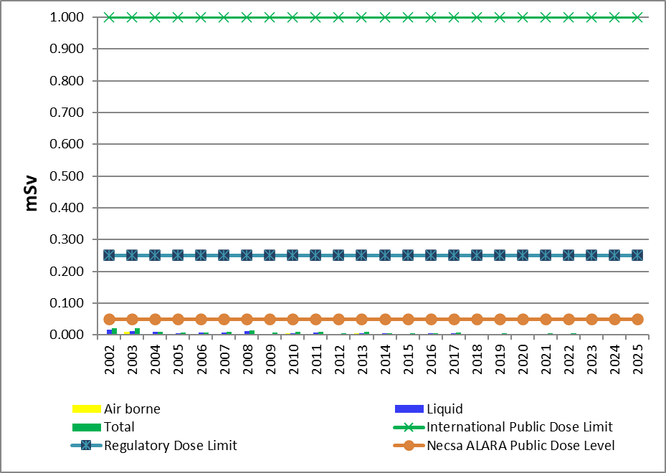
PUBLIC DOSE
 |  | Total Dose Jan-Dec 24 | Necsa ALARA Level | Regulatory dose limit | International limit
Public dose | (Jan - Dec) 2024 | 0,00306 mSv | 0,05 | 0,250 mSv | 1mSv
The public dose for the 4th quarter 2024 (Oct to Dec) due to radioactive discharges to the atmosphere was 0.000225 mSv and the public dose due to radioactive effluent released to the Crocodile River was 0.000479 mSv.
The cumulative public dose (January to December) 2024 was 0,00306 mSv that is 1.222 % of the regulatory dose limit of 0,250 mSv.
These results show that the dose impact to the public is low relative to the regulatory dose limit.

Slide 14
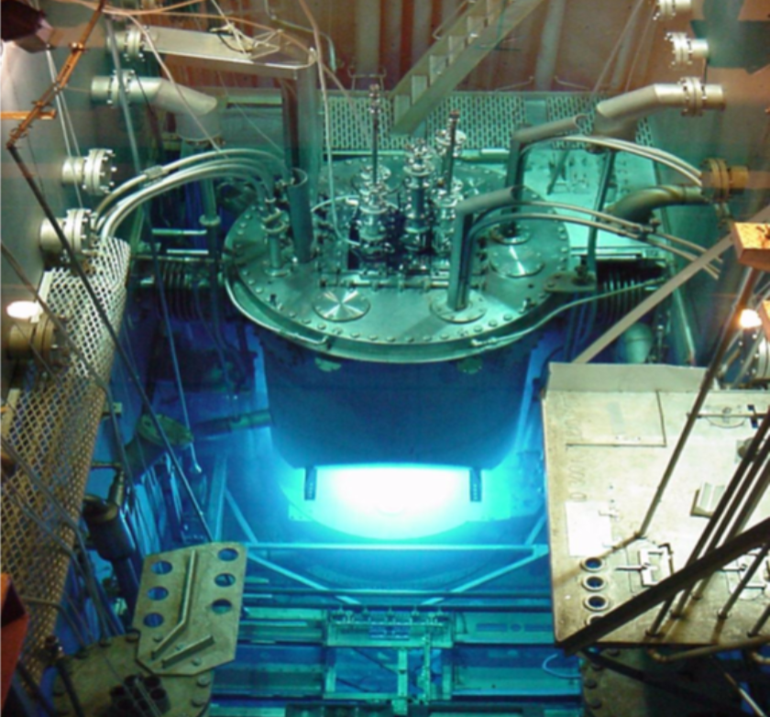
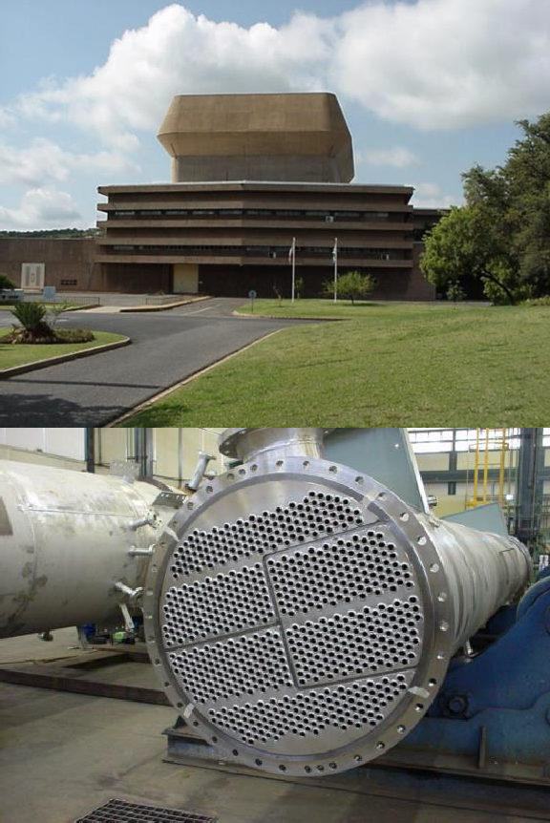
SAFARI-1 OPERATIONAL PERFORMANCE
SAFARI-1 continues an performance record as one of the best utilised and safety nuclear research reactors in the world. YTD 268.41 days availability
New license conditions limitation to 31 December 2030 – project to extend the life of SAFARI-1 by a further decade or more initiated with the NNR
Plans for the new reactor the Multipurpose Reactor (MPR) well underway with requisite government approvals

Slide 15
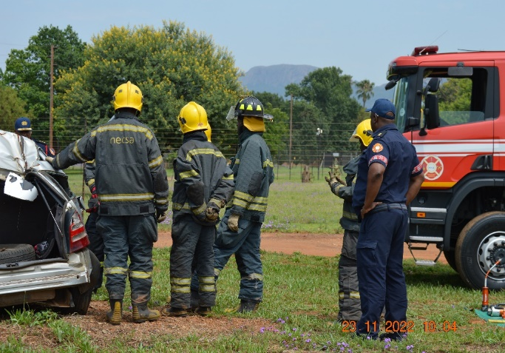
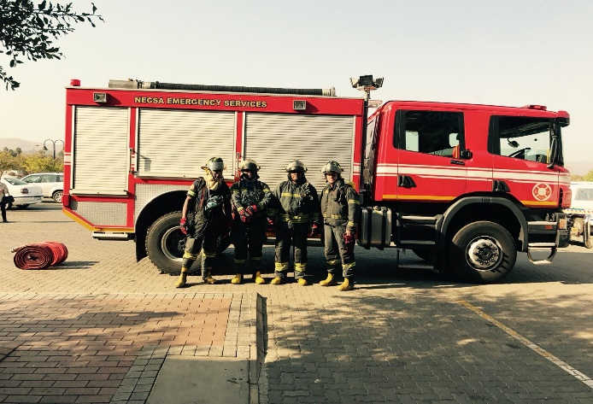
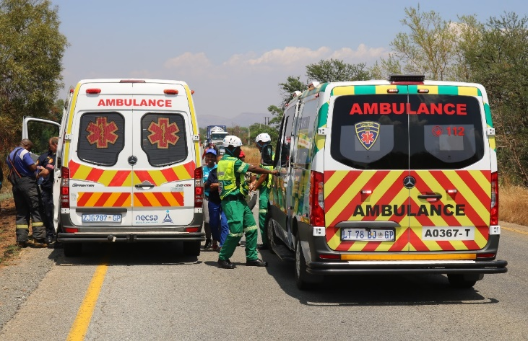
SERVICES TO SURROUNDING COMMUNITIES
November 2024 – February 2025
Vehicle Accidents
Number of vehicles accidents | 3
Number of patients Transported | 1
Animal related vehicle accidents | 0
Fire Calls
Number of fire of calls | 3
Number of patients transported | 0
Ambulance Calls
Number of fire of calls | 12
Number of patients transported | 5
Debriefing at the End of the Exercise
Response Fleet
Decontamination Showers

Slide 16
CONCLUSION
Communities around our facility are important stakeholders in the sustainability of our business and warrant to have Necsa accounting to them on safety matters.
Living the Necsa Values has led to improved safety performance and we strive to keep the value of Safety First a living and working motto.
We thank the members of the public and other stakeholders who participate at these Public Safety Information Forums for taking an interest and engaging Necsa productively.
Necsa having celebrated SAFARI-1’s 60 years of nuclear excellence remains committed to ensuring compliance with regulatory requirements for continued sustainability at all its facilities.
Necsa welcomes and looks forward to working with the new Chairperson and we wish you success.

