Slide 1
2nd Meeting of the Public Safety Information Forum (PSIF) – FY 2025/26
Loyiso Tyabashe
Group Chief Executive Officer
23 August 2025

Slide 2
PSIF AGENDA – 23 AUGUST 2025
 | ITEM | LEAD | TIME
1. | Welcome and Attendance | Thabiso Malatsi, Chairperson | 10:00 – 10:05
2. | Safety Minute | Mologadi Kekana, General Manager: Compliance Services | 10:05 – 10:10
3. | Minutes of the previous meeting | Thabiso Malatsi, Chairperson | 10:10 – 10:20
4. | Matters arising from previous minutes | Thabiso Malatsi, Chairperson | 10:20 – 10:25
5. | Necsa Group Update | Loyiso Tyabashe, GCEO | 10:25 – 11:00
 | Comments and Discussion | Thabiso Malatsi, Chairperson | 11:00 – 11:10
6. | NNR Update | Wesley Damon, Acting Programme Manager: Nuclear Technology and Waste Projects | 11:10 – 11:20
 | Comments and Discussion | Thabiso Malatsi, Acting Chairperson | 11:20 – 11:30
7. | General | Thabiso Malatsi, Chairperson | 11:30 – 11:40
8. | Closure | Thabiso Malatsi, Chairperson | 11:45

Slide 3
LEGISLATIVE REQUIREMENTS FOR PUBLIC SAFETY INFORMATION FORUM MEETINGS
  Necsa, as the holder of a nuclear installation license, holds Public Safety Information Forum to inform people living in the area that falls under the scope of the emergency plan on nuclear safety and radiation safety matters related to its activities.
  Necsa’s licensing requirements guide us in terms of key areas where we need to account to communities about the impacts of our business.
  Relevant stakeholders are invited to an open meeting on a quarterly basis.
  Nuclear Energy Act (NEA; Act No. 46 of 1999)
  Environmental compliance Acts
  Occupational Health and Safety Act
  National Nuclear Regulator Amendment Act 26 of 24
  Disaster Management Act
  Mission: To develop and safely utilise nuclear, radiation, and related technologies to make a socioeconomic impact in diverse global markets through commercial and non-commercial technologies, in an environmentally responsible manner.
  PSIF meetings demonstrates a Necsa that lives up to its values that include “Safety First”.

Slide 4
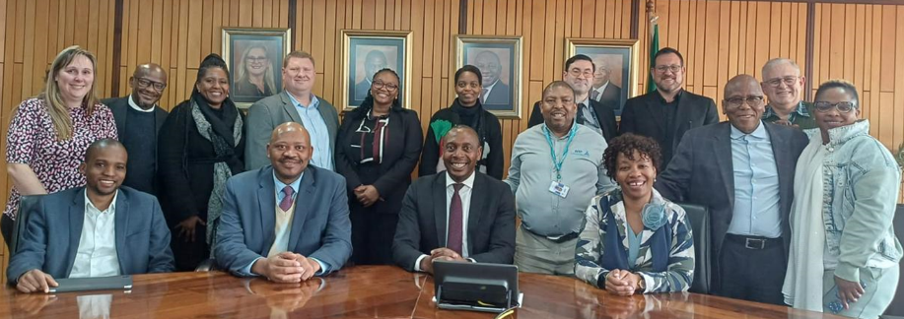
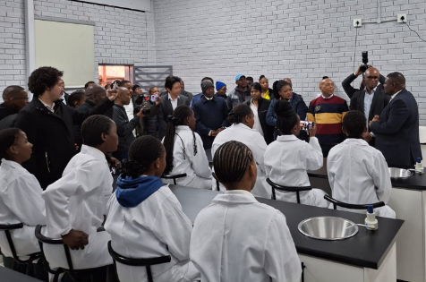
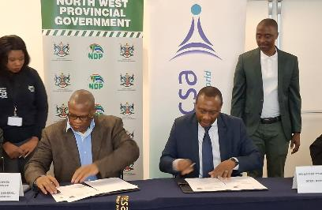
BUSINESS UPDATE
On 29 July 2025, Necsa hosted a visit from the Auditor-General of South Africa (AGSA) led by Mr Tlamelo Ramantsi
Necsa achieved a clean audit outcome report for the first time in six years, marking a significant milestone in its commitment to financial accountability and governance.
The Minister of Electricity and Energy Dr Kgosientsho Ramokgopa unveiled four new science laboratories in schools in Atteridgeville on 7 August 2025.
Premier of Gauteng Province, Mr Panyaza Lesufi, Minister of Communications and Digital Technologies Mr. Solly Malatsi, Deputy Minister in the Presidency Ms. Nonceba Mhlauli, City of Tshwane MCC for Roads and Transport Ms. Tlangi Mogale, were also present.
On 15 August 2025, Necsa and the North West Office of the Premier signed a Memorandum of Understanding to collaborate on research, training, and development initiatives aimed at uplifting the North West Province, with the Director General of the North West province, Mr Mosweu Mogotlhe signing on behalf of the Provincial Government.
Notes:
This was a 67 minutes community service initiative, inspired by Nelson Mandela. A collaborative effort between the Department of Electricity and Energy, Necsa, HUAWEI and AVON/Dedisa.
Schools of beneficiation were Hofmeyr High School, Edward Phatudi Secondary School, Bokgoni Technical School and Seaparankwe Primary School.

Slide 5
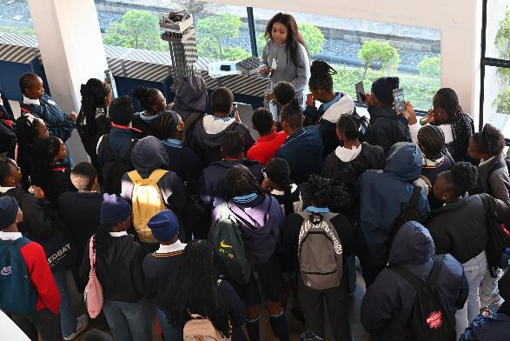
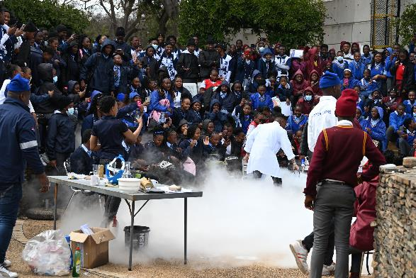
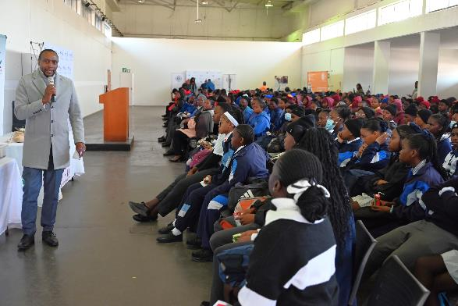
BUSINESS UPDATE
National Science Week (NSW), an annual initiative by the Department of Science, Technology and Innovation (DSTI), is a week-long celebration of science, engineering, and technology that engages thousands of learners and members of the public through interactive activities such as workshops, science shows, and lectures across the country. Held from 4 to 8 August 2025, Necsa delivered an engaging educational programme for schools in the City of Tshwane and Madibeng, reaching a total of 2,723 learners, educators, and community members. Necsa scientists and researchers presented talks showcasing their careers and contributions, while partners including NNR, NRWDI, UNISA, CSIR, CHIETA, and NYDA participated as exhibitors, enriching the experience with diverse insights and resources.

Slide 6
NECSA LICENCES AUTHORISED BY NNR
NNR (40 NILs)
03
04
05
06
07
08
09
10
11
12
13
14
15
16
17
18
19
20
21
22
23
24
25
26
27
28
29
30
31
32
33
34
35
36
37
38
39
40
41
02
NIL02 – Safari Operations
  Project initiated for long term operation of SAFARI-1 beyond it’s current license limit date of December 2030
NIL04- Thabana Pipe Store
  Activities in preparation for manufacturing and construction in progress as part of the Thabana Pipestore Extension Project
Transitional arrangements for the transfer of the Vaalputs waste disposal facility underway

Slide 7
OTHER AUTHORISATIONS
SAHPRA*
DFFE (7)
DWS (1)
HAZARDOUS SUBSTANCE ACT - (ACT 15 OF 1973)
NATIONAL ENVIRONMENTAL MANAGEMENT: BIODIVERSITY ACT (10/2004)
NATIONAL ENVIRONMENTAL MANAGEMENT: WASTE ACT (59/2008)
NATIONAL ENVIRONMENTAL MANGEMENT: AIR QUALITY ACT (39/2004)
NATIONAL WATER ACT (36/1998) (Directive)
All SAHPRA Authorisation governing NTP operations in good standing.
DFFE requirements are met with the Air Emission License issued by Bojanala in good standing.
Necsa is currently operating under Water Permit issued in 2005 and in the process of the Water Use Licence Application (WULA)

Slide 8
ENVIRONMENTAL MONITORING
RADIOLOGICAL RELEASES | Gaseous releases | NTP stacks (4) SAFARI -1 stack (1) Inconsequential stacks (29) | NNR compliance (0.05 mSv)
 | Effluent Release | Effluent release to the Crocodile River | NNR compliance (0.15 mSv)
WATER PERMIT | Effluent Release | Effluent release to the Crocodile River | DWS compliance (250 000 m³) per water year
AIR EMMISION LICENCE | Gaseous releases | Acids Production - Hydrogen Fluoride [HF] - Area V-60 Salts Production – Sodium Silica Fluoride [Na₂SiF₆] - Area V-69 Fluorine Generation – [F2] - B-H1 Surface Fluorination Production Plant - B-E3/4 Fluor Organics Production - Potassium Propanoate. [perfluoro 23- methoxypropyl] - B-C2 | Pelchem AEL licence BPDM/AEL/OCTOBER2020 Annual Air Allowable Emissions (Kg/a) @ 5mg/m³ = 17 695 kg
All environmental monitoring results are significantly below regulatory limits

Slide 9
EMERGENCY EVENTS
Unusual Event
An abnormal event that indicates an unplanned deviation from normal operation, the consequences of which require partial activation of the emergency plan.
Alert
A situation that could develop into a Site or General Emergency and therefore requires notification of all emergency functionaries (internal and external) in order to obtain a state of readiness to respond.
Site Emergency
An emergency condition that poses a serious hazard on-site, but poses no serious hazard to the public off-site.
General Emergency
An emergency condition that poses or potentially poses a serious hazard off-site requiring full implementation of the EP.
Emergency exercises are performed on a routine basis to ensure readiness of all functionaries
Members of the public are informed appropriately during emergency exercises
Partnerships with local authorities ensure that information reaches people in time
Since the last PSIF there has been no real emergency activated at Necsa

Slide 10


EMERGENCY PREPAREDNESS
NNR Initiated Exercise
1-5 September 2025
08 May
Chemical Exercise
22 August
Radiological Exercise
21 November
Security Exercise
Jan 25
Feb 25
Mar
25
Apr 25
May 25
Jun 25
Jul
25
Aug
25
Sep
25
Oct 25
Nov 25
Dec 25
07 March
Radiological Exercise
11 July
Security Exercise
03 October
Chemical Exercise
Necsa conducts various types of emergency exercises to test readiness (radiological, chemical and security events)
Between 1-5 September 2025 the NNR will initiate a Regulatory Nuclear Emergency Exercise (RNEE) at Pelindaba Site
Lessons learnt from these exercises are incorporated into Necsa’s policies and procedures to improve our responsiveness
Debriefing at the End of the Exercise
Response Fleet
Decontamination Showers

Slide 11
PUBLIC DOSE
 |  | Total Dose Jan-March 25 | Necsa ALARA Level | Regulatory dose limit | International limit
Public dose | (Jan – March) 2025 | 0,000575 mSv | 0,05 | 0,250 mSv | 1mSv
The public dose for the 1st quarter 2025 (January to March) due to radioactive discharges to the atmosphere was 0.000116 mSv and the public dose due to radioactive effluent released to the Crocodile River was 0.000459 mSv.
The cumulative public dose (January to March) 2025 was 0,000575 mSv that is 0.23 % of the regulatory dose limit of 0,250 mSv.
These results show that the dose impact to the public is low relative to the regulatory dose limit.

Slide 12
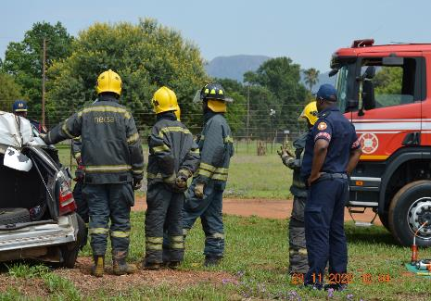
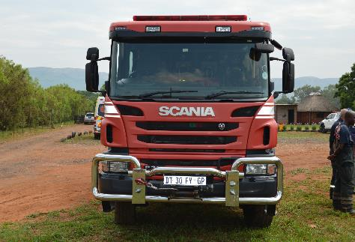
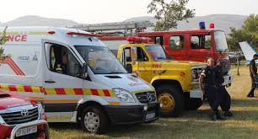
SERVICES TO SURROUNDING COMMUNITIES
June 2025 – July 2025
Vehicle Accidents
Number of vehicles accidents | 4
Number of patients Transported | 0
Animal related vehicle accidents | 0
Fire Calls
Number of fire of calls | 9
Number of patients transported | 0
Ambulance Calls
Number of ambulance calls | 22
Number of patients transported | 8
Debriefing at the End of the Exercise
Response Fleet
Decontamination Showers

Slide 13
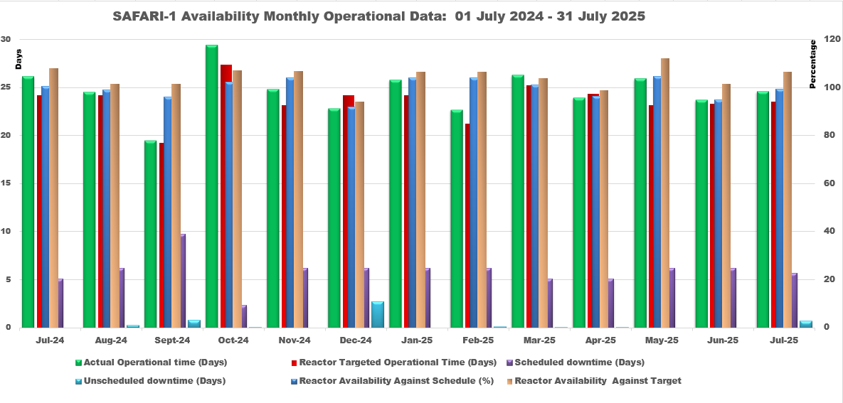
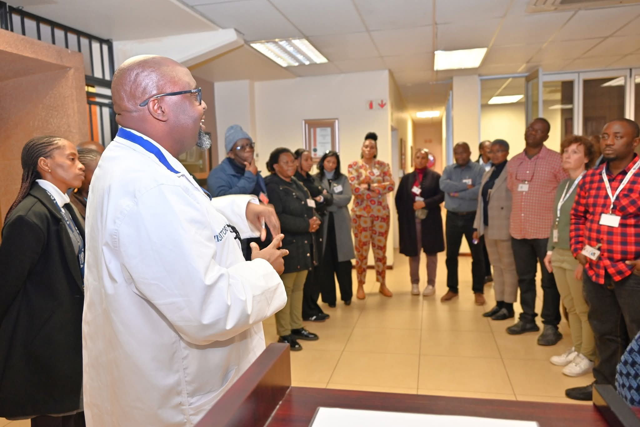
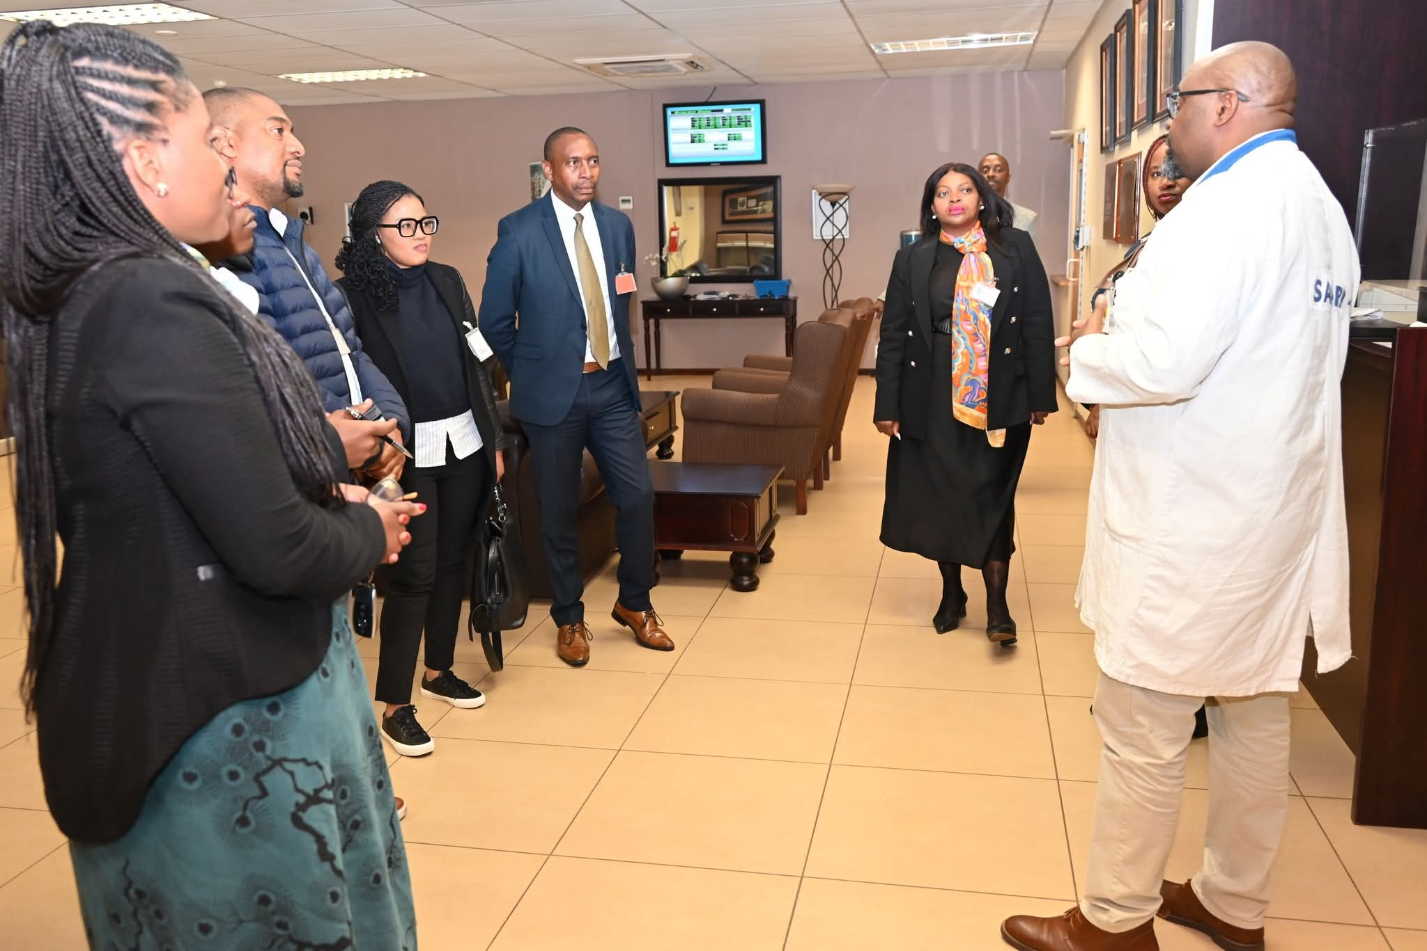
SAFARI-1 OPERATIONAL PERFORMANCE
End of Q1 (April to June 2025) SAFARI-1’s operational availability was 73.56 days against a target of 70.76 days
Two downtime events were experienced in Q1, none of which posed a safety or operational challenges for the reactor
SAFARI-1 continues to be a centre of scientific research and technology development and learning that Necsa shares with a wide variety of stakeholders

Slide 14
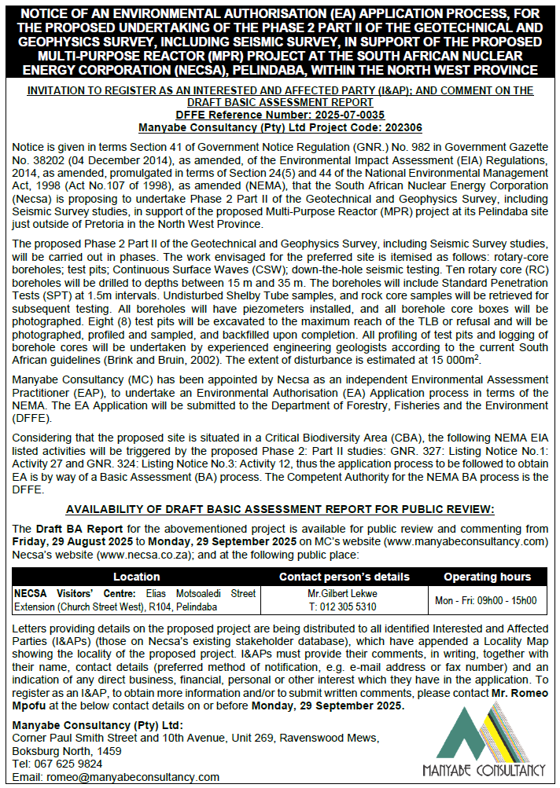
MPR GEOTECHNICAL & SEISMIC SURVEYS ENVIRONMENTAL AUTHORISATION (EA) PROCESS
Necsa notifies PSIF and the public of the EA application to conduct further studies on the preferred site for the MPR at its Pelindaba site.
Application will be lodged officially with DFFE on 29 August 2025.
Adverts have been placed with Komorant, Tshwane Sun and The Star newspapers to publish on the day.
A Public Participation Process will then be undertaken from 29 August to 29 September 2025.
Manyabe Consultancy appointed as independent practitioners to oversee the process.
Interested and affected parties are requested to register and submit comments before 29 September 2025 to shape our shared environmental future.
More info to be made available at Necsa Visitor Centre and on the websites – www.necsa.co.za or www.manyabeconsultancy.com

Slide 15
CONCLUSION
Necsa continues in ensuring safety, environmental stewardship, and emergency preparedness in its operation. This sets a good foundation for future nuclear-related projects such as the MPR, SMR, etc.
We extend our sincere appreciation to all stakeholders, including community members, regulators, and partners, who contribute to the success of these forums.
Together, we will continue to build a safe, sustainable, and forward-looking nuclear and nuclear technology-related future.
Necsa remains steadfast in its commitment to operational excellence, regulatory compliance, and transparent engagement with our surrounding communities.

