Slide 1
NECSA LEARNING ACADEMY
Clive Mokoena
Manager: HCD
20 June 2026

Slide 3
PURPOSE
The NLA adopts the vision, mission, and values to help achieve the objectives of the Talent Excellence and High Performance Strategic Pillar of Necsa Group by:
“Providing a framework to deliver training and skills development interventions for Necsa Group’s learning and development requirements, identified industry requirements and respond to the national call for development of a youthful skilled workforce”

Slide 4
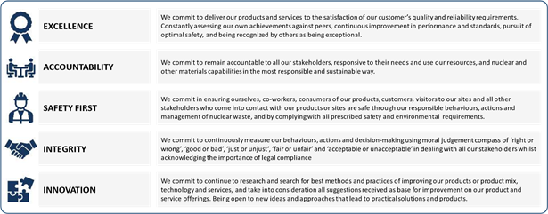
NECSA VALUES - EASII
Organisational Values (Acronym: EASII)

Slide 5
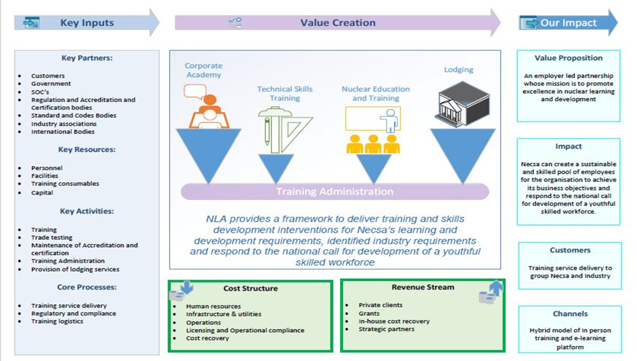
NLA BUSINESS MODEL

Slide 6
NLA ACCREDITATIONS
NLA is accredited as a Skills Development Provider and Trade Test Centre in the following:
Skills Development Provider and Trade Test Centre
The Chemical Industries Education and Training Authority (CHIETA)
Quality Council for Trade and Occupations (QCTO) –Accredited training provider for Occupational trade
The Manufacturing, Engineering and Related Services Sector Education and Training Authority (MerSETA)
Energy and Water Seta – Radiation Protection
The South African Bureau of Standards (SABS) for ISO 9001

Slide 7
STRATEGIC PARTNERSHIPS
Universities (Local and Global)
Industry Associations
SETAS (CHIETA, MerSETA, EWSETA etc))
Other SOC’s
NSF (National Skills Fund)
Department of Basic Education and Training-Schools of Specialisation
IAEA

Slide 8
TECHNICAL SKILLS STRTAEGY
A highly accredited nuclear skills training centre that aspires to fully meets the needs of all its clients:
Manufacturing industry
Automotive industry
Renewable energy ,Photo Voltaic ,wind and Nuclear energy
Entrepreneurship
Mining industry
Domestic, Industrial and Commercial installations

Slide 9
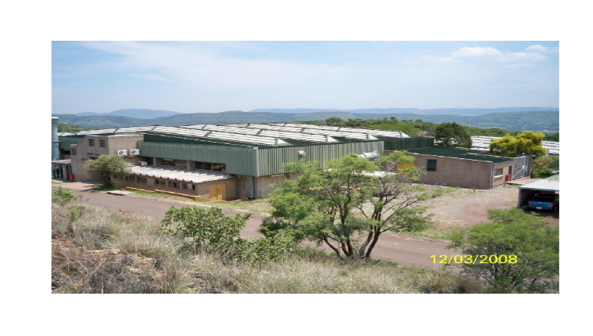
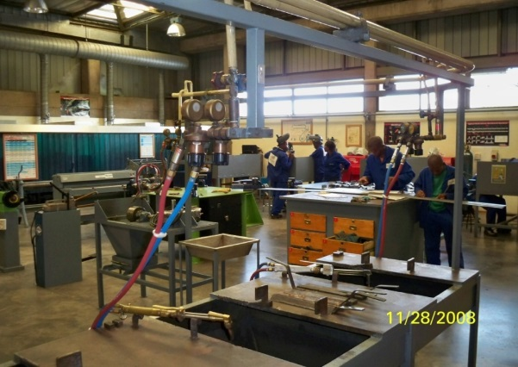
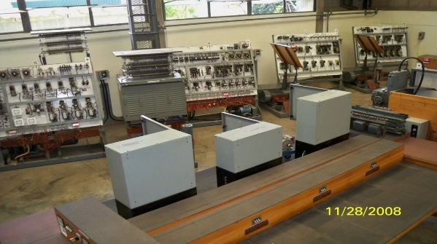
TRAINING CAPABILITY
Training Portfolio
  Fabrication (Boiler making & welding, etc.)
  Mechanical Engineering (Toolmaking; Machining; Fitter; Turner; Millwright)
  Electrical Engineering (Green Technologies)
  Control & Instrumentation
  Trade Testing Centre
  Statutory Training
  Radiation Protection Training
  Engineer in Training Programme
  R&D
  Learnerships
  Internships
  WILL
Capacity to train ±650 artisans per annum
Notes:
This was a 67 minutes community service initiative, inspired by Nelson Mandela. A collaborative effort between the Department of Electricity and Energy, Necsa, HUAWEI and AVON/Dedisa.
Schools of beneficiation were Hofmeyr High School, Edward Phatudi Secondary School, Bokgoni Technical School and Seaparankwe Primary School.

Slide 10
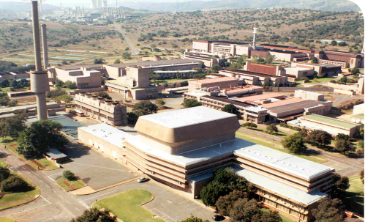
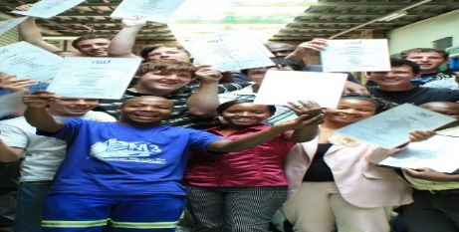

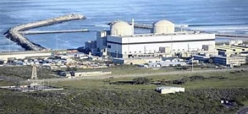
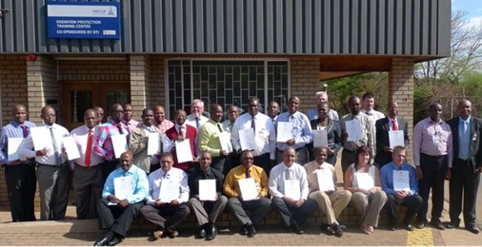
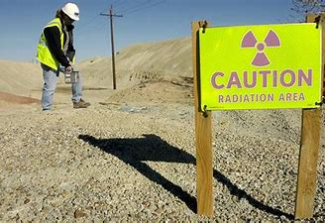
NLA’S RADIATION PROTECTION BUSINESS MODEL IS CENTRED ON STATE-OF-THE ART RADIATION PROTECTION TRAINING CENTRE (RPTC)
We train people…
Our RPTC Centre Offers a range of courses relating to Radiation Protection Monitors (RPM) and Radiation Protection Officers (RPO) training
We protect the environment…
We have a strong track record in providing radiation monitoring and protection services to internal and external nuclear facilities and mining sector. We also employ and offer on-the-job training to university graduates with nuclear/radiation sciences related qualifications to work as Radiation Protection Specialists (RPS)
RPTC (Training)
Training Outputs
Outcome: Improved Nuclear and Radiological Safety
Necsa Candidates
University/college graduates
(nuclear/radiation sciences related qualifications)
Radiation Protection Training
Trained Necsa RPOs & RPMs
Necsa Radiation Protection Technical Services
(RPOs, RPMs, RPSs)
External Candidates
Trained RPOs & RPMS from/for External Entities
Notes:
This was a 67 minutes community service initiative, inspired by Nelson Mandela. A collaborative effort between the Department of Electricity and Energy, Necsa, HUAWEI and AVON/Dedisa.
Schools of beneficiation were Hofmeyr High School, Edward Phatudi Secondary School, Bokgoni Technical School and Seaparankwe Primary School.

Slide 11

YOUTH TRAINING AND DEVELOPMENT INTERVENTION
INTERSNHIPS
LEARNERSHIPS
RPO TRAINING
WILL
APPRENTICESHIP
GRADUATES IN TRAINING
Notes:
This was a 67 minutes community service initiative, inspired by Nelson Mandela. A collaborative effort between the Department of Electricity and Energy, Necsa, HUAWEI and AVON/Dedisa.
Schools of beneficiation were Hofmeyr High School, Edward Phatudi Secondary School, Bokgoni Technical School and Seaparankwe Primary School.

Slide 12
CORE SKILLS PYRAMID
Advanced
Core
Basic
Entry Level
PhD Masters in
Engineering
& Science
Degrees in Engineering & Science
Technicians in Engineering & Science
Artisans
Operators
Talent Identification
Finance Human Resources Information Technology
Notes:
This was a 67 minutes community service initiative, inspired by Nelson Mandela. A collaborative effort between the Department of Electricity and Energy, Necsa, HUAWEI and AVON/Dedisa.
Schools of beneficiation were Hofmeyr High School, Edward Phatudi Secondary School, Bokgoni Technical School and Seaparankwe Primary School.

Slide 13
OPPORTUNITIES FOR TRAINING AND DEVELOPMENT
All adverts are placed on the necsa website periodically (internships, learnerships, apprenticeships ,skills programmes,trade testing, WILL, OJT and Graduate in Training)
Minimum requirements are qualification specific
Recruitment is national, unless stated so by the donor/funder
Limited student lodging available on site
Notes:
This was a 67 minutes community service initiative, inspired by Nelson Mandela. A collaborative effort between the Department of Electricity and Energy, Necsa, HUAWEI and AVON/Dedisa.
Schools of beneficiation were Hofmeyr High School, Edward Phatudi Secondary School, Bokgoni Technical School and Seaparankwe Primary School.

Slide 14



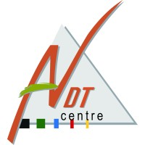













CLIENT LIST
Notes:
This was a 67 minutes community service initiative, inspired by Nelson Mandela. A collaborative effort between the Department of Electricity and Energy, Necsa, HUAWEI and AVON/Dedisa.
Schools of beneficiation were Hofmeyr High School, Edward Phatudi Secondary School, Bokgoni Technical School and Seaparankwe Primary School.

Slide 15
COMPANIES
African NDT centre
Anglo American mining
Department of Electricity and Energy
Highveld steel
ICB (coca cola SA)
Lafage mining
Robotube
SAIW
SAPS (bomb squad; forensic; hawks)
Sasol
Tiger Weel
WBHO
Department of Defence Force
Nampak Bevcan Angolata LDA
Nampak Bevcan Nigeria
Nampak Bevcan SA Rosslyn
BMW
SARS
Eskom
Denel
Transnet Engineering
Nissan South Africa
Northam Eland Plantinum
National Brand Limited
Bridgestone Firestone SA
University of Pretoria
Powertech
Pioneer Hi-Bred R.S.A (PTY) LTD
Adcock Ingram
Hazelton Pump
Orbit TVET College
Glencore
Afrox
Notes:
This was a 67 minutes community service initiative, inspired by Nelson Mandela. A collaborative effort between the Department of Electricity and Energy, Necsa, HUAWEI and AVON/Dedisa.
Schools of beneficiation were Hofmeyr High School, Edward Phatudi Secondary School, Bokgoni Technical School and Seaparankwe Primary School.

Slide 16



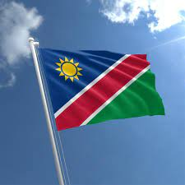


COUNTRIES WHERE SERVICES ARE OFFERED
Botswana
Cote D, Ivore
Tanzania
Nigeria
Angola
Namibia
Notes:
This was a 67 minutes community service initiative, inspired by Nelson Mandela. A collaborative effort between the Department of Electricity and Energy, Necsa, HUAWEI and AVON/Dedisa.
Schools of beneficiation were Hofmeyr High School, Edward Phatudi Secondary School, Bokgoni Technical School and Seaparankwe Primary School.

Slide 17
CONTACT INFORMATION
Contact Details
Mr Clive Mokoena
Manager : Human Capital Development
Necsa Learing Academy
Email: clive.mokoena@necsa.co.za
Cell : 082 940 5500
Notes:
This was a 67 minutes community service initiative, inspired by Nelson Mandela. A collaborative effort between the Department of Electricity and Energy, Necsa, HUAWEI and AVON/Dedisa.
Schools of beneficiation were Hofmeyr High School, Edward Phatudi Secondary School, Bokgoni Technical School and Seaparankwe Primary School.

